Slide 1
ESPD Annual Seminar 2022
30th November 2022

Slide 2
Table of contents
Introduction
ESPD-EDM v3.0.1 (2022 Q1)
ESPD-EDM v3.1.0 (2022 Q4)
ESPD-EDM v4.0.0 (2023 Q1)
BREAK
Replacement of UUIDs (ESPD-EDM v4.0.0)
Update of the ESPD-EDM webpages and documentation

Slide 3
Introduction
Paloma Arillo Aranda, Publications Office

Slide 4
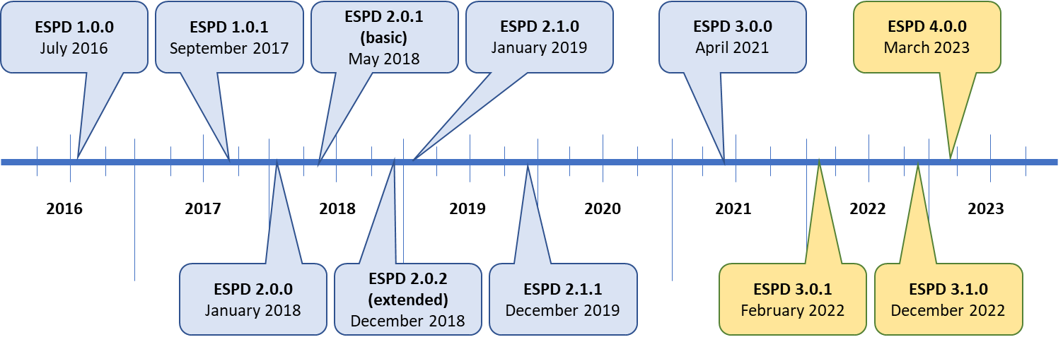
Introduction
Main milestones of 2022:
A patch version of the ESPD, v3.0.1, released in February;
A minor version of the ESPD, v3.1.0, released in December.
A major version of the ESPD-EDM will be release in the first quarter of 2023 (v4.0.0), which will include relevant changes and improvements.
Notes:
Article 59 of the public procurement Directive 2014/24/EU introduced a new concept: the European Single Procurement Document.
As of April 2018, the ESPD must be used electronically.
This standard form is set up in Annex 2 of the Commission Implementing Regulation (EU) 2016/72 of 5 January 2016.
To make use of the ESPD the European Commission developed an on-line service available for buyers and economic operators which allowed to create, edit, export and import electronic documents in XML format for the exchange of criteria, requirements, statements and references to evidences.
This tool is no longer maintained by the Commission and the Member States are in charge of developing their ESPD Services.
The ESPD, is a self-declaration form intended for preliminary evidence of economic operators in EU public procurement procedures.
By removing the need to produce a substantial number of certificates and documentation related to exclusion and selection criteria, the European Commission aims to reduce the administrative burden reported by many suppliers, especially small and medium-sized enterprises (SMEs).
The ESPD replaces certificates issued by public authorities or a third party involved in a procedure by mapping equivalent certificates between Member States.
The ESPD facilitates cross-border participation and it is a useful tool for integrating the European Single Market.

Slide 5

Introduction
During 2022, 7 Open User Community meetings were held, with an average participation of above 30 users from different countries:
Date of the OUC meeting | Number of participants | Different countries
27/01/2022
24/02/2022 | 30 | 13
31/03/2022 | 35 | 14
28/04/2022 | 29 | 16
16/06/2022 | 28 | 11
28/09/2022 | 29 | 14
27/10/2022 | 33 | 14
Notes:
Article 59 of the public procurement Directive 2014/24/EU introduced a new concept: the European Single Procurement Document.
As of April 2018, the ESPD must be used electronically.
This standard form is set up in Annex 2 of the Commission Implementing Regulation (EU) 2016/72 of 5 January 2016.
To make use of the ESPD the European Commission developed an on-line service available for buyers and economic operators which allowed to create, edit, export and import electronic documents in XML format for the exchange of criteria, requirements, statements and references to evidences.
This tool is no longer maintained by the Commission and the Member States are in charge of developing their ESPD Services.
The ESPD, is a self-declaration form intended for preliminary evidence of economic operators in EU public procurement procedures.
By removing the need to produce a substantial number of certificates and documentation related to exclusion and selection criteria, the European Commission aims to reduce the administrative burden reported by many suppliers, especially small and medium-sized enterprises (SMEs).
The ESPD replaces certificates issued by public authorities or a third party involved in a procedure by mapping equivalent certificates between Member States.
The ESPD facilitates cross-border participation and it is a useful tool for integrating the European Single Market.

Slide 6
Introduction
During 2022:
The Open User Community members have opened 38 issues in GitHub;
The ESPD Team has solved 29 issues.
Currently, there are 14 issues open in GitHub (5 of those are depending on a third party):
https://github.com/OP-TED/ESPD-EDM/issues
Notes:
Article 59 of the public procurement Directive 2014/24/EU introduced a new concept: the European Single Procurement Document.
As of April 2018, the ESPD must be used electronically.
This standard form is set up in Annex 2 of the Commission Implementing Regulation (EU) 2016/72 of 5 January 2016.
To make use of the ESPD the European Commission developed an on-line service available for buyers and economic operators which allowed to create, edit, export and import electronic documents in XML format for the exchange of criteria, requirements, statements and references to evidences.
This tool is no longer maintained by the Commission and the Member States are in charge of developing their ESPD Services.
The ESPD, is a self-declaration form intended for preliminary evidence of economic operators in EU public procurement procedures.
By removing the need to produce a substantial number of certificates and documentation related to exclusion and selection criteria, the European Commission aims to reduce the administrative burden reported by many suppliers, especially small and medium-sized enterprises (SMEs).
The ESPD replaces certificates issued by public authorities or a third party involved in a procedure by mapping equivalent certificates between Member States.
The ESPD facilitates cross-border participation and it is a useful tool for integrating the European Single Market.

Slide 7
ESPD-EDM v3.0.1 (2022 Q1)
Alba Colomer Padrosa, NTTDATA

Slide 8
ESPD-EDM v3.0.1 (2022 Q1)
ESPD-EDM v3.0.1 was a patch release released in February 2022.
The complete distribution package is available in GitHub: OP-TED/ESPD-EDM Tag v3.0.1
ESPD-EDM v3.0.1 provided updates covering:
Reorganisation of the GitHub repository;
Update cardinalities in the online documentation;
Update of cardinalities in the xml example files.

Slide 9
ESPD-EDM v3.0.1 (2022 Q1)
Reorganisation of the GitHub repository (editorial change):
Reorganise the distribution package folders;
Update the ESPD-EDM conceptual model;
Document handbook migration to Ted Developer Docs;
Update wiki homepage.

Slide 10
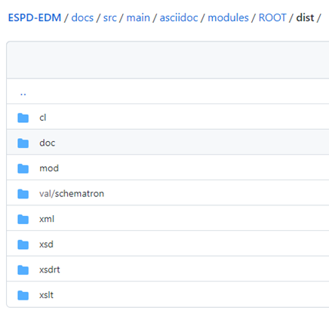
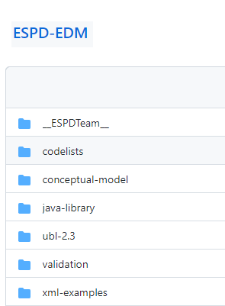
ESPD-EDM v3.0.1 (2022 Q1)
Reorganisation of the GitHub repository - Reorganisation of the distribution package folders:

Slide 11
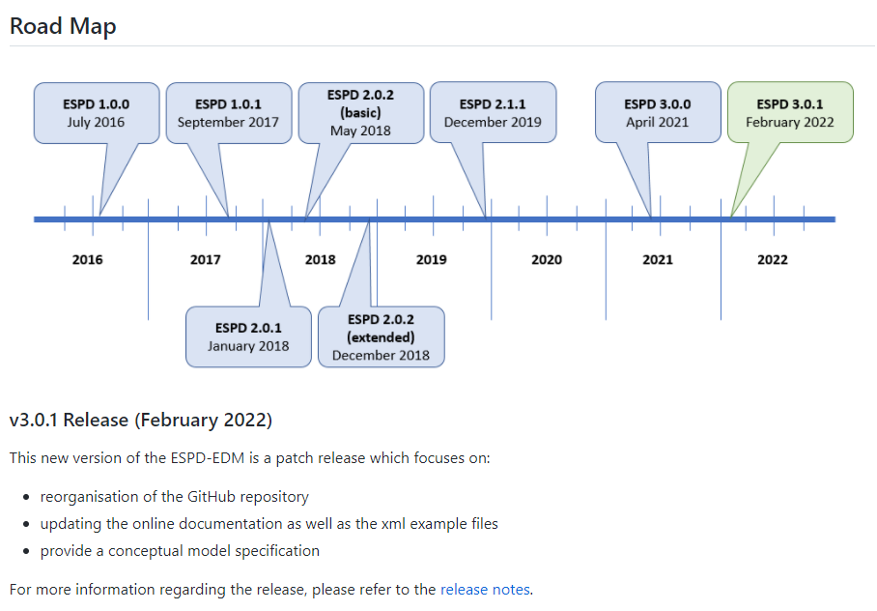
ESPD-EDM v3.0.1 (2022 Q1)
Reorganisation of the GitHub repository - Update wiki homepage:

Slide 12
ESPD-EDM v3.0.1 (2022 Q1)
Update cardinalities in the online documentation (small bug fix):
Update cardinalities according to the online documentation review feedback;
Coordinated with the conceptual model specification;
Update code lists to the latest EU Vocabularies version, which implies the creation of TestBed new branch.

Slide 13
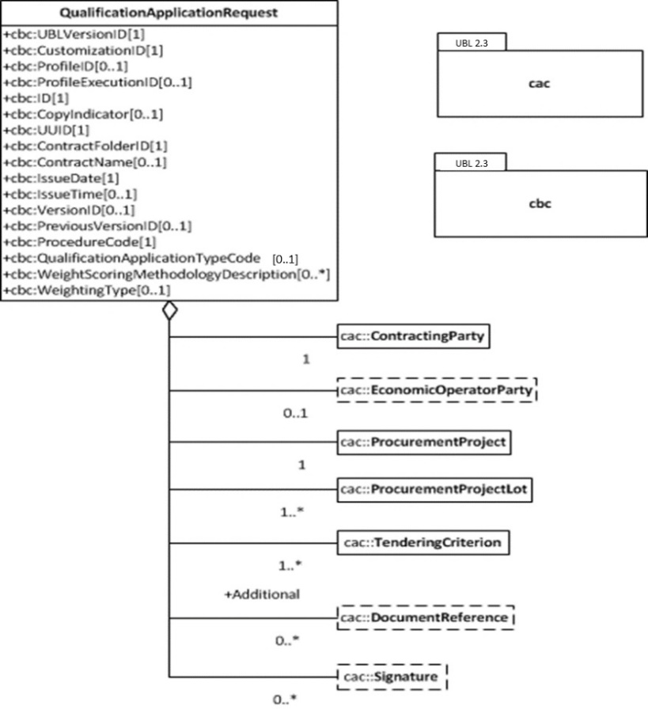
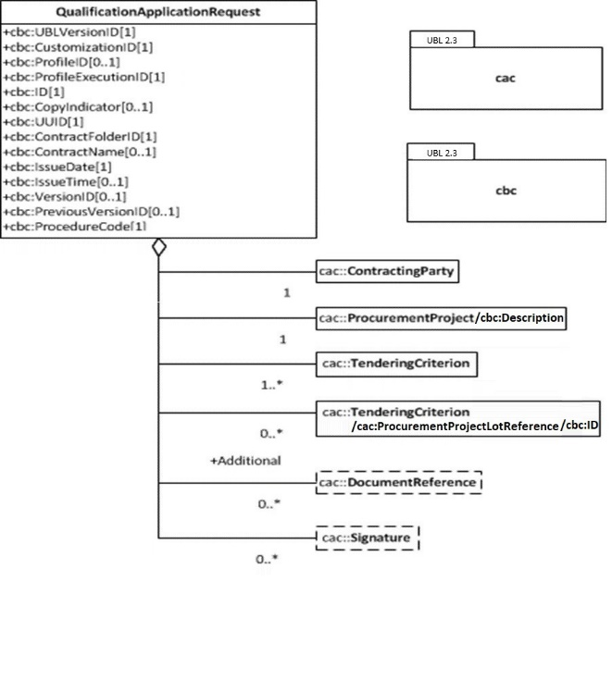
ESPD-EDM v3.0.1 (2022 Q1)
Update cardinalities in the online documentation – ESPD Request:

Slide 14
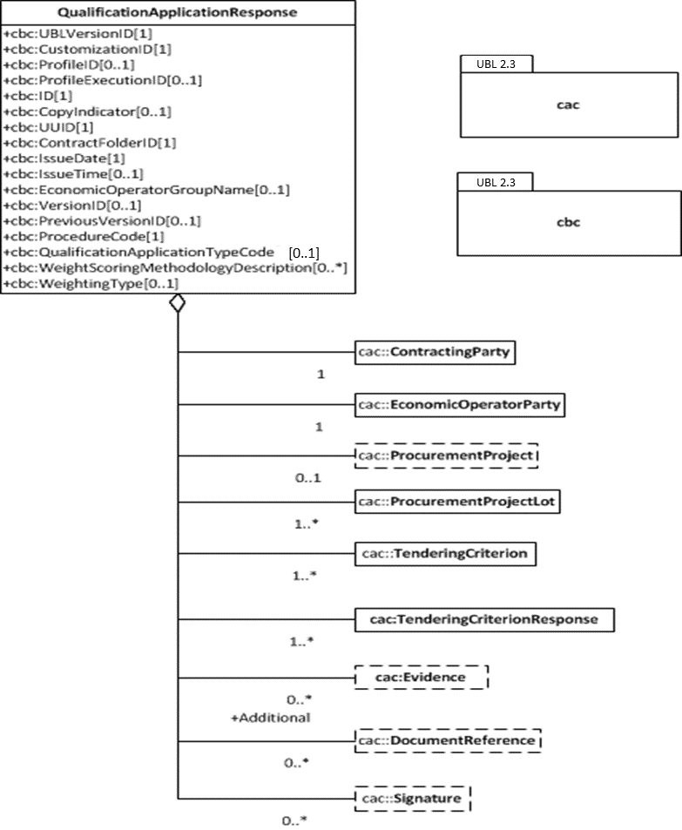
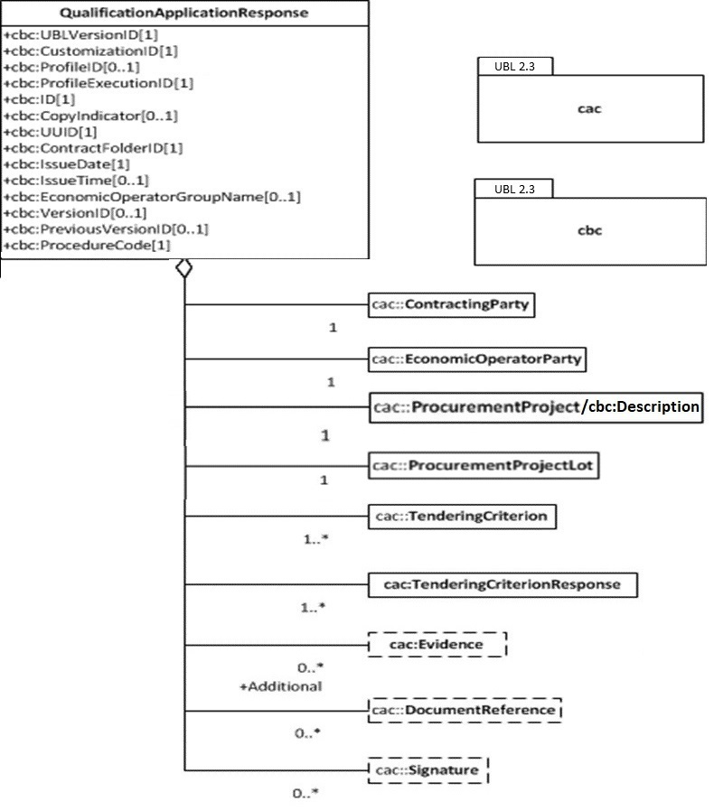
ESPD-EDM v3.0.1 (2022 Q1)
Update cardinalities in the online documentation – ESPD Response:

Slide 15
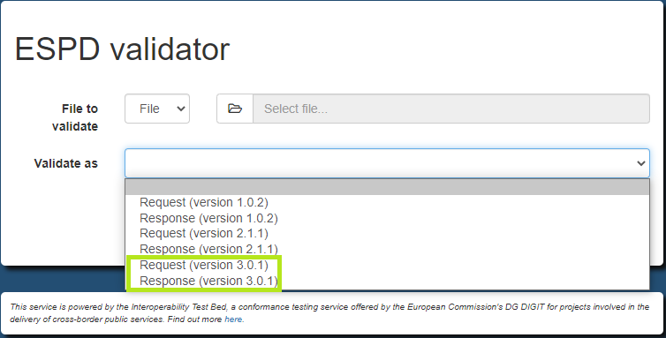
ESPD-EDM v3.0.1 (2022 Q1)
Update cardinalities in the online documentation – New version available in TestBed:

Slide 16
ESPD-EDM v3.0.1 (2022 Q1)
Update of cardinalities in the xml example files (small bug fix):
Update the xml examples according to the online documentation update;
Small bug fix.

Slide 17
ESPD-EDM v3.1.0 (2022 Q4)
Alba Colomer Padrosa, NTTDATA

Slide 18
ESPD-EDM v3.1.0 (2022 Q4)
ESPD-EDM v3.1.0 is a minor release that will be released in December 2022.
All changes included in the release are already implemented in the master branch. Currently, the ESPD Team is working in the preparation of the documentation for the release.
ESPD-EDM v3.1.0 will provide updates covering:
Subcontracting proportion;
Occupation code list (ESCO);
Corrections in the data structure;
Schematron rules;
Corrections in code lists;
Revision of the conceptual model;
ESPD Test Cases Mapping Documentation.

Slide 19
ESPD-EDM v3.1.0 (2022 Q4)
Item | Change | Related issues
Subcontracting proportion | A new optional requirement section has been added to the criterion 51 with cardinality 0..n | #287
Occupation code list (ESCO) | The current technical code list is replaced by the code list provided by EU Vocabularies with the updated values from ESCO (Multilingualclassification of European Skills, Competences, Qualifications and Occupations, https://esco.ec.europa.eu/) Removal of the option “Other occupations” from documentation | #307, #347
Corrections in the data structure | Data misplacement in several lines in Criteria 35, 52 and 53 Incorrect or missing cardinalities Incorrect use of the UUID New requirement within a requirement group to show the number of fiscal years to be covered | #320, #322, #326, #327, #333, #338, #340, #343, #346, #350

Slide 20
ESPD-EDM v3.1.0 (2022 Q4)
Item | Change | Related issues
Schematron rules | Incorrect validation related to the ProfileID version | #324
Corrections in code lists | Data Type: date format in code list Criterion Financial ratio type: inconsistency between the language label and the actual language | #332, #337

Slide 21
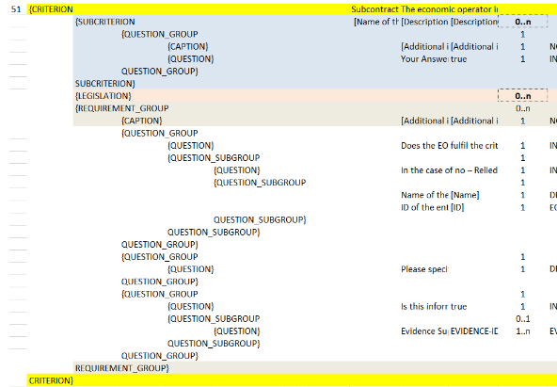
ESPD-EDM v3.1.0 (2022 Q4)
Subcontracting proportion (#287)
An optional requirement section has been added to the criterion 51 with cardinality 0..n.
A new UUID has been generated:
75b14cf3-c30f-4b8f-b9ab-549ff5ba595a

Slide 22
ESPD-EDM v3.1.0 (2022 Q4)
Occupation code list (ESCO) - #307, #347
The Occupation code list maintained by EU Vocabularies will be used instead of the technical code list;
The ESPD-EDM v3.1.0 includes the gc generated by EU Vocabularies, maintains the metadata on the repository, and the validation rules have been updated accordingly;
This code list does not include the code "0000.0“ - other occupations;
Option “Other occupations” has been removed from the data structure in the criterion C25 SC prof-regist, and will also be removed from the documentation to avoid any misunderstanding.

Slide 23
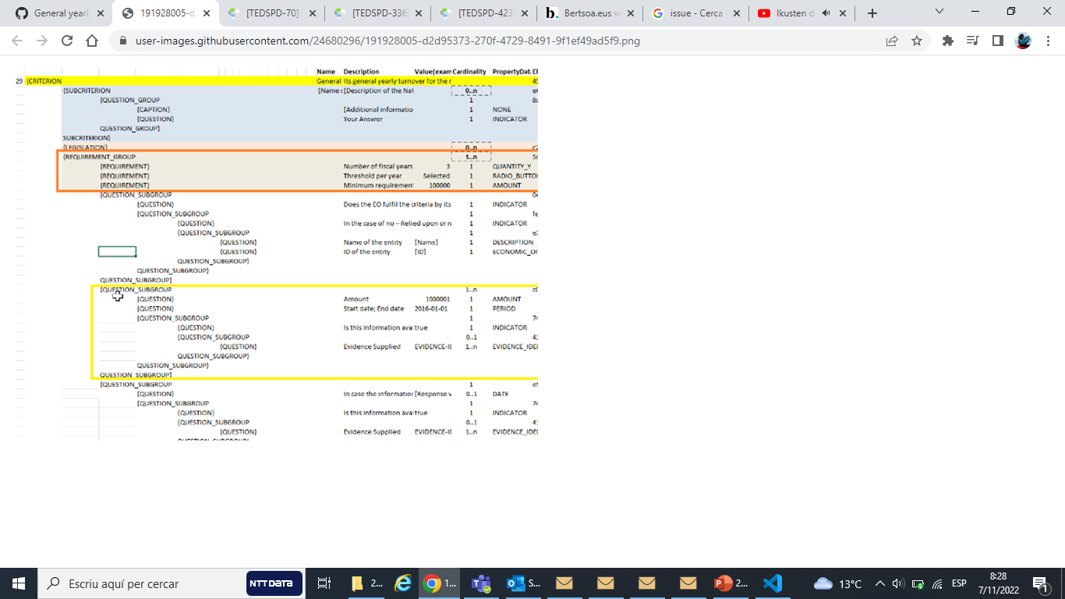
ESPD-EDM v3.1.0 (2022 Q4)
Corrections in the data structure (#340)
A requirement that represents the number of fiscal years to be covered in the requirement group within criterion "General yearly turnover“, has been added;
An intermediate requirement that represents the selection of “Threshold per year" has been added.

Slide 24
ESPD-EDM v3.1.0 (2022 Q4)
Corrections in the data structure (#340)
When the yearly turnover is required for different years, the question_subgroup must be replicated.
A new UUID to cover this data structure has been generated.

Slide 25
ESPD-EDM v3.1.0 (2022 Q4)
Conceptual model
The conceptual model is available here:
https://docs.ted.europa.eu/ESPD-EDM/3.0.1/_attachments/ESPD_CM_html/index.html
The conceptual model has been refined and cleansed, as well as updated to ensure consistency with the changes of ESPD-EDM v3.1.0 release.
Both the ESPD-EDM-BusinessView (BOV) and the ESPD-EDM-UBLTechnicalView (TOV) of the conceptual model have been exhaustively reviewed and updated accordingly.
The conceptual model will be shared with the eProcurement Ontology Working Group.

Slide 26
ESPD-EDM v3.1.0 (2022 Q4)
ESPD Test Cases Mapping Documentation
For ESPD v2, the document “ESPD Test Cases Mapping” was available, which provided detailed information regarding business rules.
The goals of this document were:
For each test case, identify the related business rules, describe the Schematron rules and map them with UBL-2.2 XSD;
To validate the criteria taxonomy and facilitate the understanding of the different validation artefacts in the ESPD-EDM.
Since it has been reported that this document was a helpful tool for technical implementation (GitHub issue #331), a simplified version of it is being elaborated and will be provided as an annex to the Technical Handbook.

Slide 27
ESPD-EDM v4.0.0 (2023 Q1)
Alba Colomer Padrosa, NTTDATA

Slide 28
ESPD-EDM v4.0.0 (2023 Q1)
ESPD-EDM v4.0.0 will be a major release scheduled for March 2023.
ESPD-EDM v4.0.0 will provide updates covering:
Different requirements for different lots;
Update of the current UUID for repeatable subgroups;
Corrections in the data structure;
Purely National Exclusion Grounds;
Corrections in code lists.
The final scope of the ESPD-EDM v4.0.0 is pending formal approval from the Change Management Board

Slide 29
ESPD-EDM v4.0.0 (2023 Q1)
Item | Change | Related issues
Different requirements for different lots | Correction of an issue so different requirements can be set for different lots within a selection criterion | N/A
Update of the current UUID for repeatable subgroups | Update excel criterion files and generation of xml samples files XSLT updates: transformation from Excel to XML ESPD | #312
Purely National Exclusion Grounds | Creation of an xml file test that includes question subgroup with multiple cardinality "1..n" replicated twice, allowing to provide more than one Purely National Exclusion Ground criterion Update the Data Structure | #334*
Corrections in code lists | Revision of description texts to ensure consistency between eCertis and the Taxonomy Correction of a duplicated code in the occupations codelist | #336, #339, #348
Validation rules | Create validation rules for mandatory fields Create validation rules for all ESPD code lists | N/A
* All tasks completed on ESPD side. Tasks on eCertis side still pending.

Slide 30
ESPD-EDM v4.0.0 (2023 Q1)
Different requirements for different lots
The ESPD selection criteria include requirements, which are specific constraints from the Buyer for specific Lots within a procurement procedure.
The last major release of the ESPD was aligned with eForms, from both the business and technical perspective.
ESPD Request
Issue:
Business view: There are selection criteria that can implement different requirements per lot
Technical view: The current technical implementation does not allow multiple and different requirement per lot.
EG
ALL LOTS
SC1
LOT1
LOT2
SC2
LOT2

Slide 31
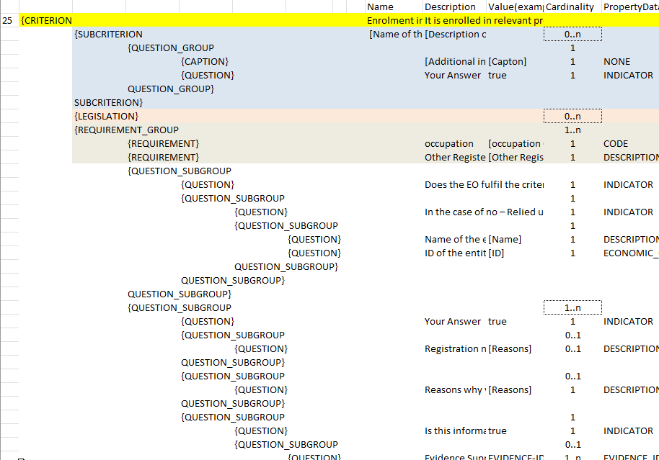
ESPD-EDM v4.0.0 (2023 Q1)
Different requirements for different lots. AS-IS data structure view (v3.0.1)
With this logic, a requirement within a selection criterion is unique
Therefore, all lots that the criterion targets would have the same requirements
There is no field / requirements within the requirement to establish the Lot targeted

Slide 32
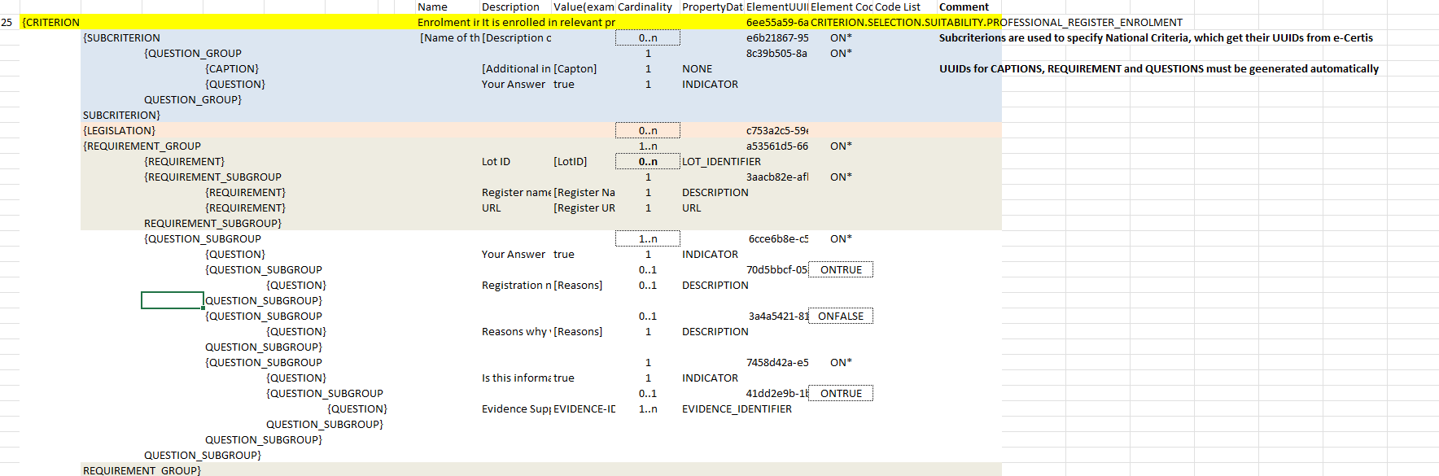
ESPD-EDM v4.0.0 (2023 Q1)
Different requirements for different lots. TO-BE data structure view (as implemented in v2.1.1)
Inclusion of a field / requirement to specify LOTS where it applies
Requirements could be replicated (cardinality 1..n)
Lots would be referenced two times: one at the beginning of the criteria, and second within the requirement

Slide 33
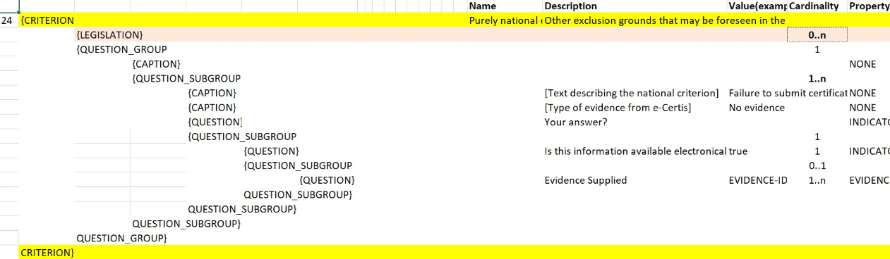
ESPD-EDM v4.0.0 (2023 Q1)
Purely National Exclusion Grounds (#334)
Update of the Data Structure aimed at a more natural (semantic) way of providing evidences;
Update of the whole Criteria Excel file (not only for Purely National Exclusion Grounds).

Slide 34
REPLACEMENT of UUIDs (ESPD-EDM v4.0.0)
Alba Colomer Padrosa, NTTDATA

Slide 35
Replacement of UUIDs (ESPD-EDM v4.0.0)
A universally unique identifier (UUID) is a 128-bit label used for information identification.
UUIDs are machine-oriented and not human readable.
Example: a1534624-95cf-4519-bdaa-856d5acf59b6
When generated according to the standard methods, UUIDs are, for practical purposes, unique.
While the probability that a UUID will be duplicated is not zero, it is close enough to zero to be negligible.

Slide 36
Replacement of UUIDs (ESPD-EDM v4.0.0)
In the ESPD, 2 types of UUID are used:
Fixed (or static) UUIDs, for elements such as:
Criterion, SubCriterion;
Legislation;
Group or SubGroup (Question_Group, Question_SubGroup, Requirement_Group, Requirement_SubGroup).
Dynamic UUIDs, generated at the creation of an ESPD Request or and ESPD Response, for descriptive elements:
Question;
Requirement;
Caption.

Slide 37
Replacement of UUIDs (ESPD-EDM v4.0.0)
Problem statement:
Currently, questions in criteria need to be instantiated for each procurement procedure instead of reusing criteria from earlier procurement procedures.
Business requirements:
Ensure the connection for each criterion between ESPD Request and Response;
Ensure reusability of criteria both in the Request and the Response across procurement procedures;
Facilitate traceability and The Once-Only Principle (TOOP).
Proposed solution:
Reduce the randomness on the ESPD Request by no longer using dynamic UUIDs and defining fixed identifiers for requirements and questions (identifiers are already fixed for criteria).

Slide 38
Replacement of UUIDs (ESPD-EDM v4.0.0)
The current UUID will be replaced by a pre-defined short tag name for each element and a numbering according to the position within the tree structure.
The solution provides a path to a target criterion element.
The new pattern focuses on the alignment of tags, syntax readability and indexing separation:
C1_EG_crime-org/QG1/QSG1/Q1
C1_EG_crime-org/QG1/QSG1/Q1/R2
C32_SC_spec-year-to/RG1/QSG2/Q2/R2

Slide 39
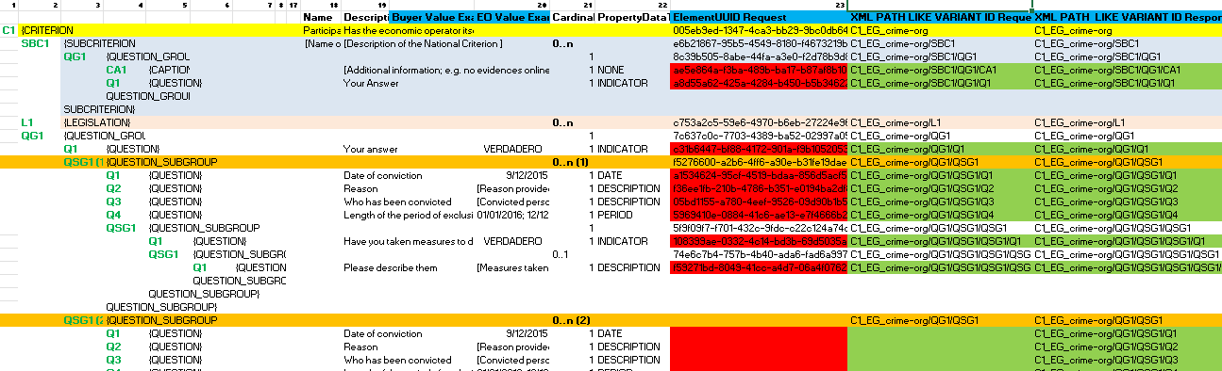
Replacement of UUIDs (ESPD-EDM v4.0.0) ESPD-EDM v3.1.0 vs ESPD-EDM v4.0.0
Example of the UUIDs that will be removed (in red) and of the new identifiers that will be used for the Request and the Response (in green)

Slide 40
Replacement of UUIDs (ESPD-EDM v4.0.0) Criterion elements’ short tag and matching UBL element
Criterion Element Short Tag Name | Criterion Element | UBL Element
C | CRITERION (Exclusion GroundsEG, Selection Criterion SC) | cac:TenderingCriterion
SBC | SUBCRITERION | cac:SubTenderingCriterion
L | LEGISLATION | cac:Legislation
CA | CAPTION | cac:TenderingCriterionProperty
Q | QUESTION | cac:TenderingCriterionProperty
RQ | REQUIREMENT | cac:TenderingCriterionProperty
QG | QUESTION_GROUP | cac:TenderingCriterionPropertyGroup
QSG | QUESTION_SUBGROUP | cac:SubsidiaryTenderingCriterionPropertyGroup
RG | REQUIREMENT_GROUP | cac:TenderingCriterionPropertyGroup
RSG | REQUIREMENT_SUBGROUP | cac:SubsidiaryTenderingCriterionPropertyGroup
R | RESPONSE (OCCURRENCE) | cac:TenderingCriterionResponse
RV | RESPONSE VALUE | cac:ResponseValue
RES | (RESPONSE) EVIDENCE SUPPLIED | cac:EvidenceSupplied
RAP | (RESPONSE) APPLICABLE PERIOD | cac:ApplicablePeriod

Slide 41
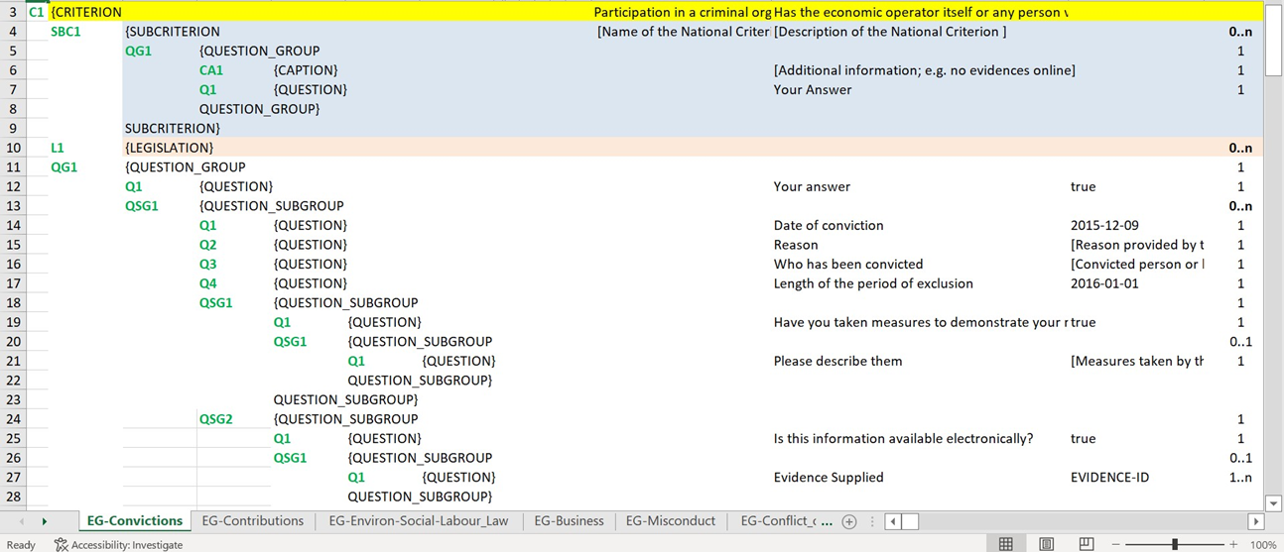
Replacement of UUIDs (ESPD-EDM v4.0.0) Management of Questions
Example of the tagging and numbering of the criterion C1 EG crime-org

Slide 42
Replacement of UUIDs (ESPD-EDM v4.0.0) Management of Questions
Path samples - Questions
UUID AS-IS Question ID
a1534624-95cf-4519-bdaa-856d5acf59b6 (Q1 "Date of conviction")
f36ee1fb-210b-4786-b351-e0194ba2df89 (Q2 "Reason")
New identifiers (XML path-like) for Question ID (structure)
C1_EG_crime-org/QG1/QSG1/Q1
C1_EG_crime-org/QG1/QSG1/Q2
C32_SC_spec-year-to/RG1/QSG2/Q2
New identifiers (XML path-like) for EO responses (contents)
C1_EG_crime-org/QG1/QSG1/Q1/R1
C1_EG_crime-org/QG1/QSG1/Q1/R2
C32_SC_spec-year-to/RG1/QSG2/Q2/R2/RV

Slide 43
Replacement of UUIDs (ESPD-EDM v4.0.0) Management of Questions
Example of question structure description:
<cac:TenderingCriterionProperty>
<cbc:ID schemeID = "criterion" schemeAgencyID = "XXESPD-SERVICEXXX" schemeVersionID = “4.0.0">C1_EG_crime-org/QG1/QSG1/Q1</cbc:ID>
<cbc:Description>Date of conviction</cbc:Description>
<cbc:TypeCode listID = "criterion-element-type" listAgencyID = "OP" listVersionID = " 4.0.0 ">QUESTION</cbc:TypeCode>
<cbc:ValueDataTypeCode listID = "response-data-type" listAgencyID = "OP" listVersionID = " 4.0.0 ">DATE</cbc:ValueDataTypeCode>
</cac:TenderingCriterionProperty>
ID of the question
Description of the question
Type code of the question
Data type of the question

Slide 44
Replacement of UUIDs (ESPD-EDM v4.0.0) Management of Questions
Example of question contents description (ESPD Response) - Response Value (RV 1)
<cac:TenderingCriterionResponse>
<cbc:ID schemeID = "ISO/IEC 9834-8:2008 - 4UUID" schemeAgencyID = "XXESPD-SERVICEXXX" schemeVersionID = “4.0.0">C1_EG_crime-org/QG1/QSG1/Q1/R1</cbc:ID>
<cbc:ValidatedCriterionPropertyID schemeID = "Criterion" schemeAgencyID = "XXESPD-SERVICEXXX" schemeVersionID = “4.0.0">
C1_EG_crime-org/QG1/QSG1/Q1</cbc:ValidatedCriterionPropertyID>
<cac:ResponseValue>
<cbc:ID schemeID = "ISO/IEC 9834-8:2008 - 4UUID" schemeAgencyID = "XXESPD-SERVICEXXX" schemeVersionID = “4.0.0">C1_EG_crime-org/QG1/QSG1/Q1/R1/RV</cbc:ID>
<cbc:ResponseDate>2014-01-01</cbc:ResponseDate>
</cac:ResponseValue>
</cac:TenderingCriterionResponse>
ID of the tendering response
ID of the question
ID of the response value (RV)

Slide 45
Replacement of UUIDs (ESPD-EDM v4.0.0) Management of Questions
Example of question contents description (ESPD Response) - Response Value (RV 2)
<cac:TenderingCriterionResponse>
<cbc:ID schemeID = "ISO/IEC 9834-8:2008 - 4UUID" schemeAgencyID = "XXESPD-SERVICEXXX" schemeVersionID = “4.0.0">C1_EG_crime-org/QG1/QSG1/Q1/R2</cbc:ID>
<cbc:ValidatedCriterionPropertyID schemeID = "Criterion" schemeAgencyID = "XXESPD-SERVICEXXX" schemeVersionID = “4.0.0">
C1_EG_crime-org/QG1/QSG1/Q1</cbc:ValidatedCriterionPropertyID>
<cac:ResponseValue>
<cbc:ID schemeID = "ISO/IEC 9834-8:2008 - 4UUID" schemeAgencyID = "XXESPD-SERVICEXXX" schemeVersionID = “4.0.0">C1_EG_crime-org/QG1/QSG1/Q1/R2/RV</cbc:ID>
<cbc:ResponseDate>2017-01-01</cbc:ResponseDate>
</cac:ResponseValue>
</cac:TenderingCriterionResponse>
ID of the tendering response
ID of the question
ID of the response value (RV)

Slide 46
Replacement of UUIDs (ESPD-EDM v4.0.0) Management of Questions
Example of question contents description (ESPD Response) - Response Evidence Supplied (RES)
<cac:TenderingCriterionResponse>
<cbc:ID schemeID = "ISO/IEC 9834-8:2008 - 4UUID" schemeAgencyID = "XXESPD-SERVICEXXX" schemeVersionID = “4.0.0">C1_EG_crime-org/QG2/QSG1/Q1/R1</cbc:ID>
<cbc:ValidatedCriterionPropertyID schemeID = "Criterion" schemeAgencyID = "XXESPD-SERVICEXXX" schemeVersionID = “4.0.0">
C1_EG_crime-org/QG2/QSG1/Q1</cbc:ValidatedCriterionPropertyID>
<cac:EvidenceSupplied>
<cbc:ID schemeAgencyID = "XXESPD-SERVICEXXX">
EVIDENCE-00001/C1_EG_crime-org/QG2/QSG1/Q1/R1/RES</cbc:ID>
</cac:EvidenceSupplied>
</cac:TenderingCriterionResponse>
ID of the tendering response
ID of the question
ID of the evidence (Respone Evidence Supplied, RES)

Slide 47
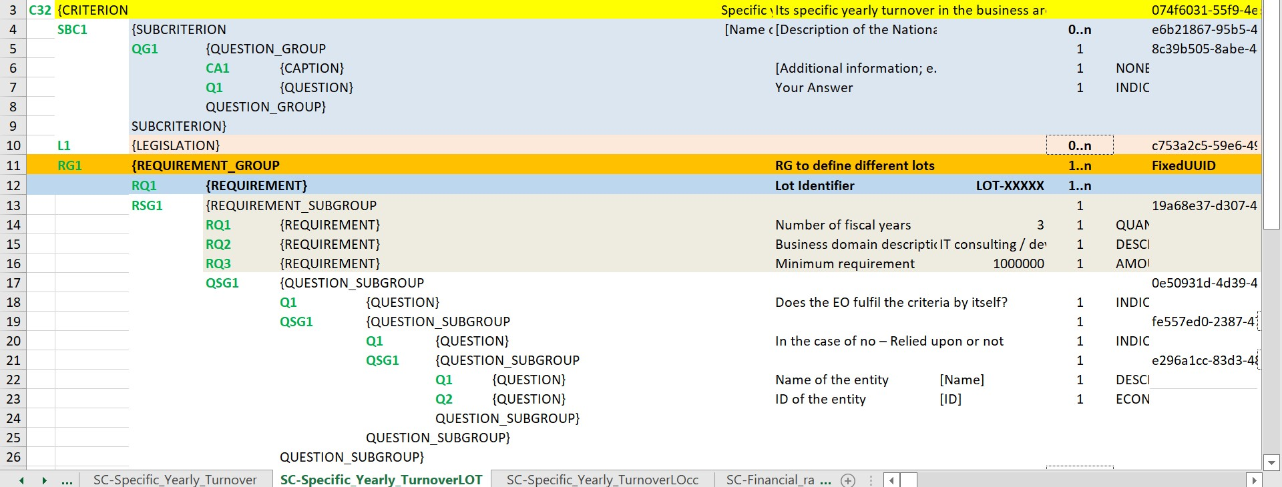
Replacement of UUIDs (ESPD-EDM v4.0.0) Management of Requirements
Example of the management of Requirements (RQ) and LOTS, as implemented in v2.1.1

Slide 48
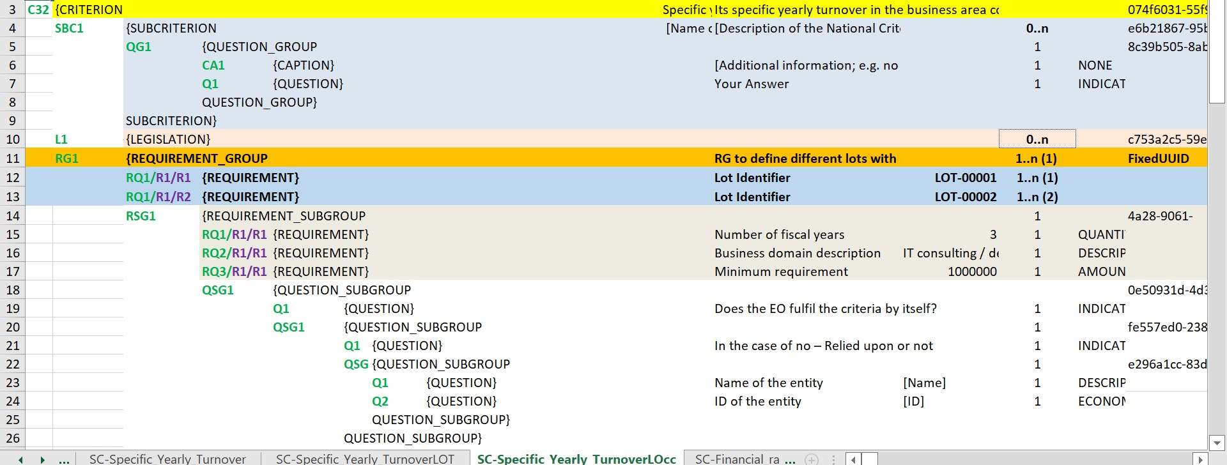
Replacement of UUIDs (ESPD-EDM v4.0.0) Management of Requirements
First occurrence (lots 1 and 2)

Slide 49
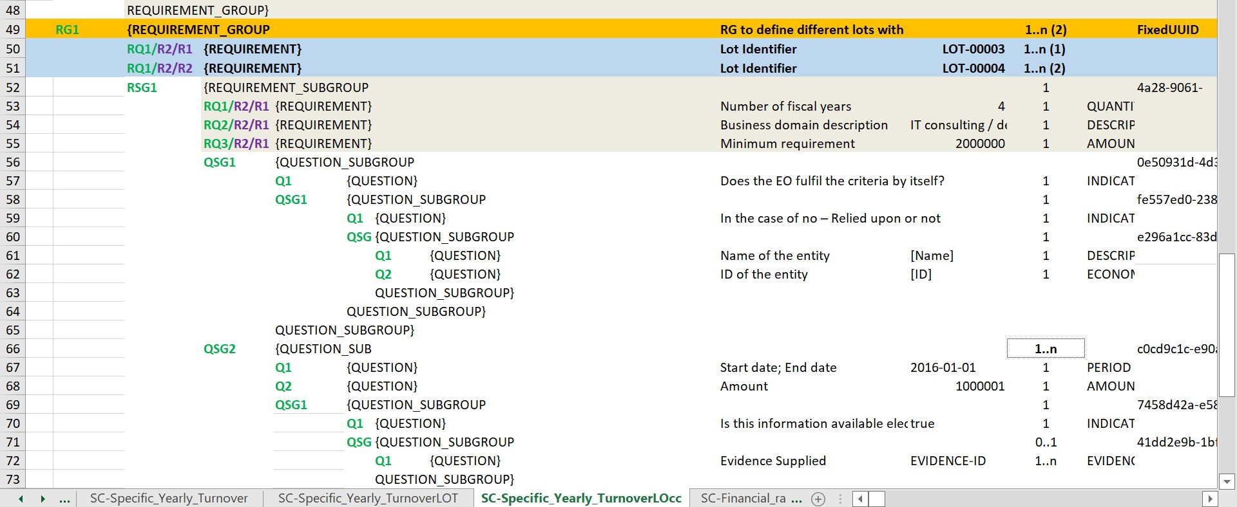
Replacement of UUIDs (ESPD-EDM v4.0.0) Management of Requirements
Second occurrence (lots 3 and 4)

Slide 50
Replacement of UUIDs (ESPD-EDM v4.0.0) Management of Requirements
Path samples - Requirements (values are nested in the structure)
UUID AS-IS Requirement ID
8d23f156-be4f-4fc7-ae87-c4b2bde59366 (RQ1 "Number of fiscal years")
bf8a8e1d-ad69-4bb9-a023-81b924cb9049 (RQ3 "Minimum Amount")
New identifiers (XML path-like) for Requirement ID (structure and occurrence indexing)
C32_SC_spec-year-to/RG1/RSG1/RQ1/R1/R1
C32_SC_spec-year-to/RG1/RSG1/RQ3/R2/R1

Slide 51
Replacement of UUIDs (ESPD-EDM v4.0.0) Management of Requirements
Example of requirements values description (ESPD Request) – RG, RQ, LOT
<cac:TenderingCriterionProperty>
<cbc:ID schemeID="Criterion" schemeAgencyID="XXESPD-SERVICEXXX" schemeVersionID=“4.0.0">C32_SC_spec-year-to/RG1/RQ1/R1/R2</cbc:ID>
<cbc:Description>Lot Identifier (General to the RG Occurrence)</cbc:Description>
<cbc:TypeCode listID="CriterionElementType" listAgencyID="OP" listVersionID=“4.0.0">REQUIREMENT</cbc:TypeCode>
<cbc:ValueDataTypeCode listID="ResponseDataType" listAgencyID="OP" listVersionID=" 4.0.0 ">LOT_IDENTIFIER</cbc:ValueDataTypeCode>
<cbc:ExpectedID schemeAgencyID="XXESPD-SERVICEXXX">LOT-00002 </cbc:ExpectedID>
</cac:TenderingCriterionProperty>
ID of the requirement
Additional information about the requirement
Description of the requirement
Type code
Data type
Value

Slide 52
Replacement of UUIDs (ESPD-EDM v4.0.0) Management of Requirements
Example of requirements values description (ESPD Request) – RG, RQ, QSG:
<cac:TenderingCriterionProperty>
<cbc:ID schemeID = "criterion" schemeAgencyID = "XXESPD-SERVICEXXX" schemeVersionID = “4.0.0">C32_SC_spec-year-to/RG1/RSG1/RQ1/R1/R1</cbc:ID>
<cbc:Description>Number of fiscal years (Target QSG: C32_SC_spec-year-to/RG1/RSG1/QSG2)</cbc:Description>
<cbc:TypeCode listID = "criterion-element-type" listAgencyID = "OP" listVersionID = " 4.0.0 ">REQUIREMENT</cbc:TypeCode>
<cbc:ValueDataTypeCode listID = "response-data-type" listAgencyID = "OP" listVersionID = " 4.0.0 ">QUANTITY_YEAR</cbc:ValueDataTypeCode>
<cbc:ExpectedValueNumeric>3</cbc:ExpectedValueNumeric>
</cac:TenderingCriterionProperty>
ID of the requirement
Additional information about the requirement
Description of the requirement
Type code
Data type
Value

Slide 53
Replacement of UUIDs (ESPD-EDM v4.0.0)
Implications of the solution
Dynamic UUIDs are replaced by an xml path-like pattern;
Structure changes: new tag element (QG1, QSG1, Q1, RG1, RSG1, RQ1, R1, R2) for each element or element group;
New algorithm to automatically compute and analyse the path to each element (question/requirement) in the structure and contents of the ESPD Request and its related ESPD Responses;
Criterion files update (both Excel and XML);
Online documentation update.

Slide 54
Replacement of UUIDs (ESPD-EDM v4.0.0)
Benefits of the solution
The link between an ESPD Request and its related ESPD Responses (one or several) is consistent;
Same structures use the same pattern;
There is no ambiguity when addressing structures represented by the same pattern;
The same data structure can be reused in different procedures;
ESPD Responses can be easily read and mapped;
Content of the ESPD can be easily reused, except in those cases where requirements are not compatible.

Slide 55
Update of the ESPD-EDM webpages and documentation
Alba Colomer Padrosa, NTTDATA

Slide 56
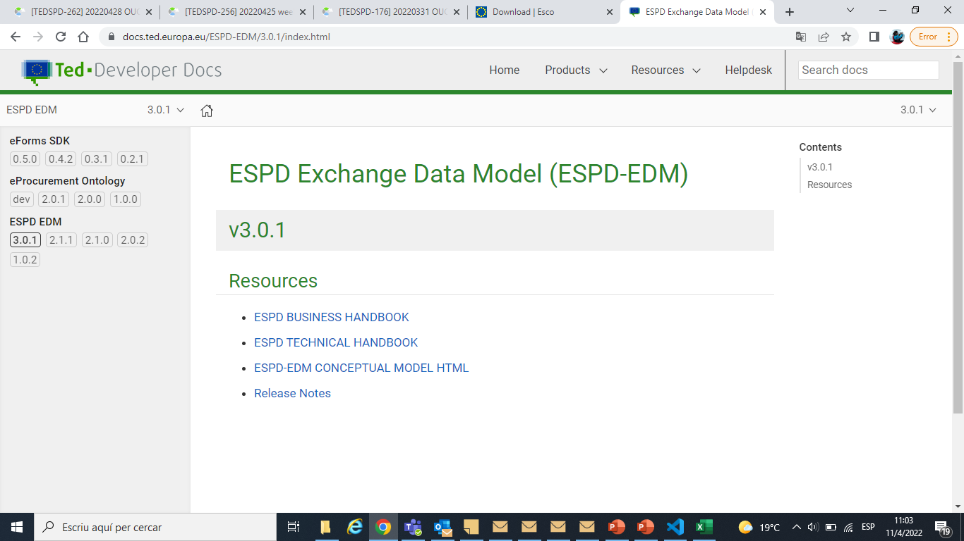
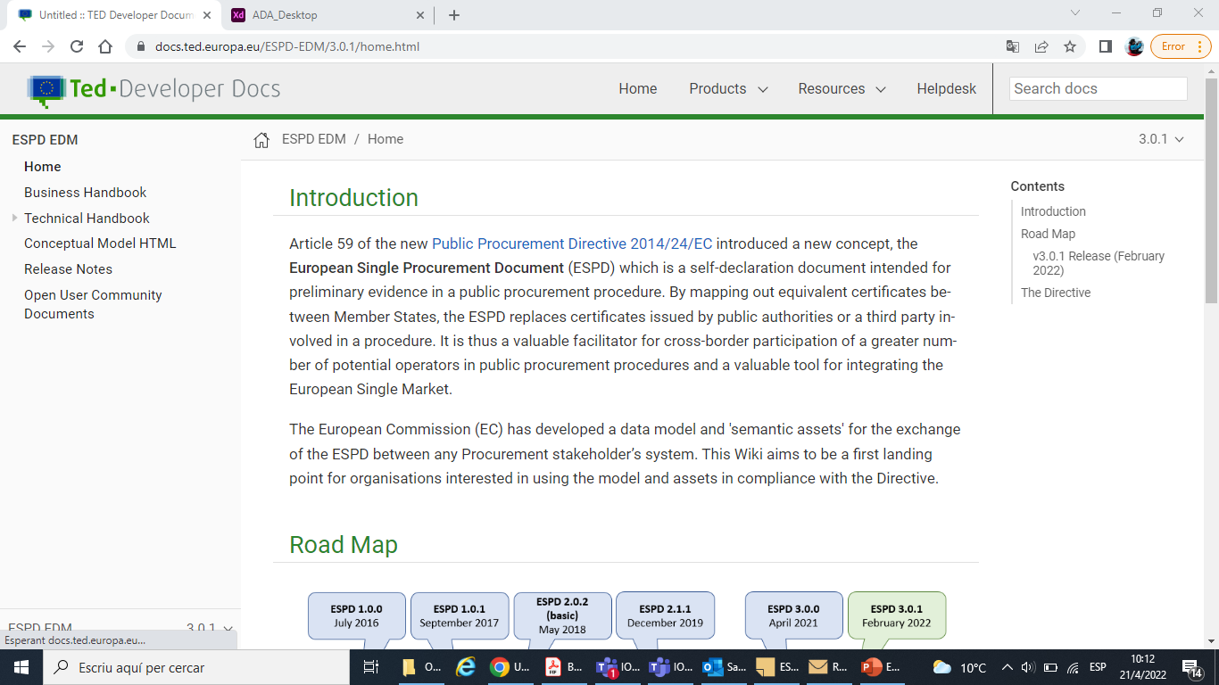
Update of the ESPD-EDM webpages and documentation
From v3.0.1, lateral navigation menu was updated:
Previous versions are available through drop-down menus at the upper right corner of the screen and at the bottom of the navigation menu.
Links to eForms and EPO projects were removed (but are still accessible from https://docs.ted.europa.eu/home/index.html).

Slide 57
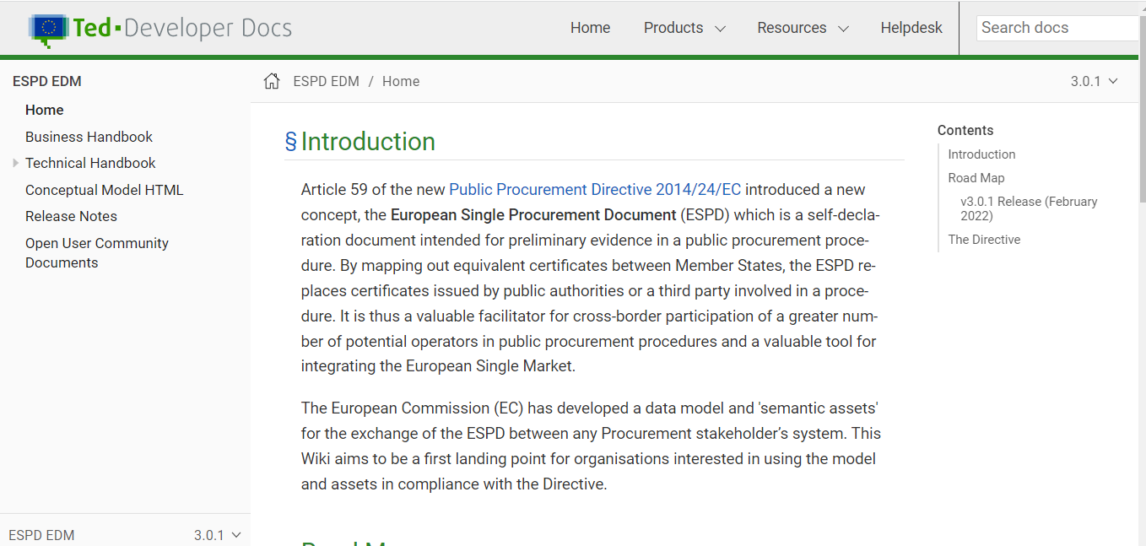
Update of the ESPD-EDM webpages and documentation
ESPD EDM v3.0.1 webpage: https://docs.ted.europa.eu/ESPD-EDM/3.0.1/index.html

Slide 58
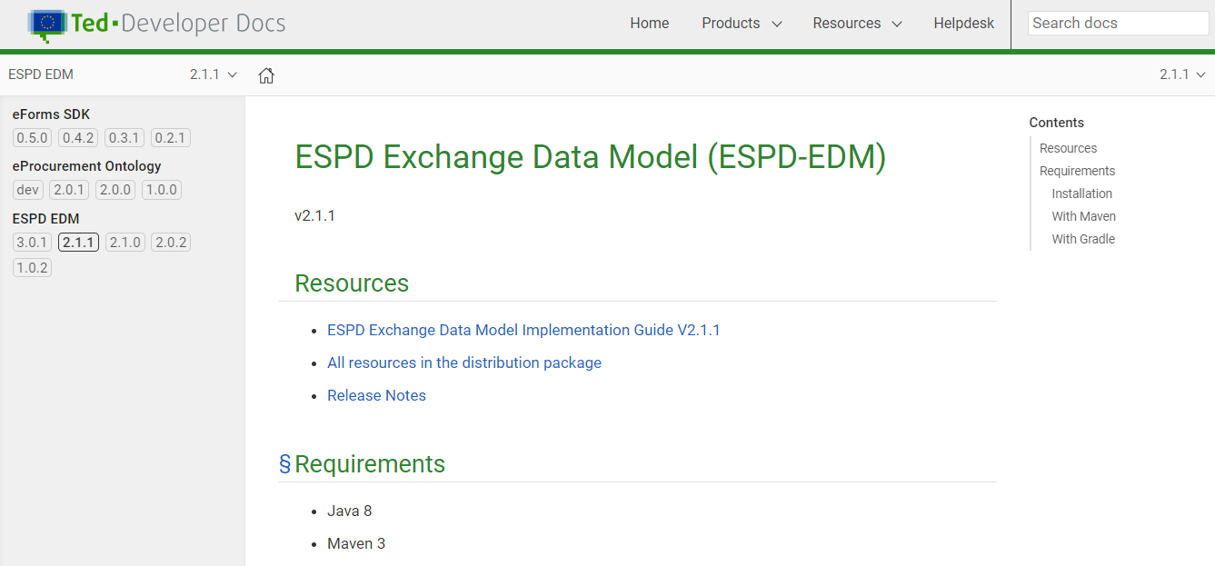
Update of the ESPD-EDM webpages and documentation
ESPD EDM previous versions:

Slide 59
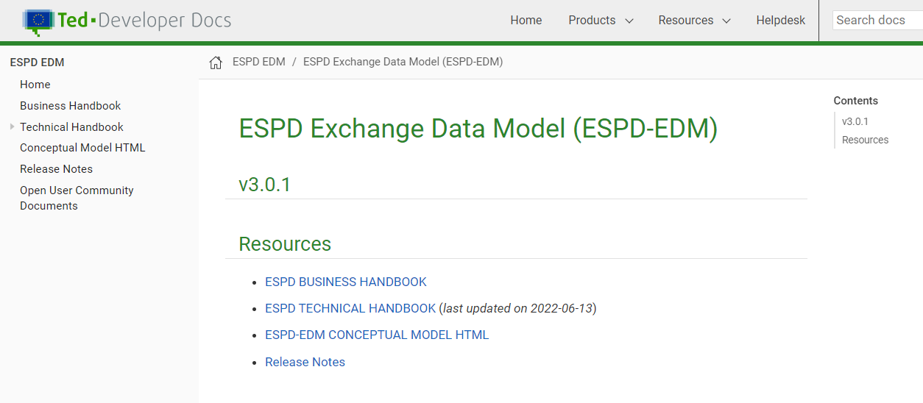
Update of the ESPD-EDM webpages and documentation
Access to online documentation: https://docs.ted.europa.eu/ESPD-EDM/3.0.1/index.html

Slide 60
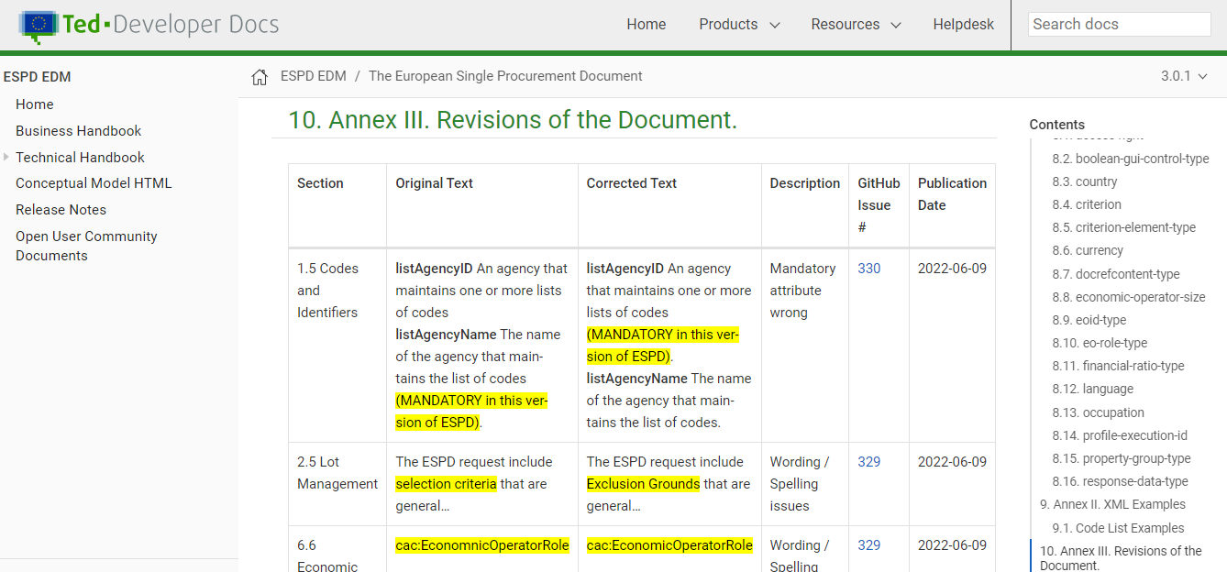
Update of the ESPD-EDM webpages and documentation
New section with the change log:

Slide 61
Thank you FOR YOUR PRESENCE Any questions?
Please feel free to send also your questions to
OPESPD@publications.europa.eu

